Slide 1
Globalisation 1

Slide 2
Globalisation and postcolonial studies
Structure of power
Is globalisation synonomous with imperialism ?
Cultural identity at a local level
Issues of postmodernity

Slide 3
Globalisation
Political, cultural or economic ?
Globalisation and modernity
The autonomy of the nation state
Deterritorialisation/migration

Slide 4
Radicals and sceptics
Hyperglobalist
Transformationalist
Sceptics

Slide 5
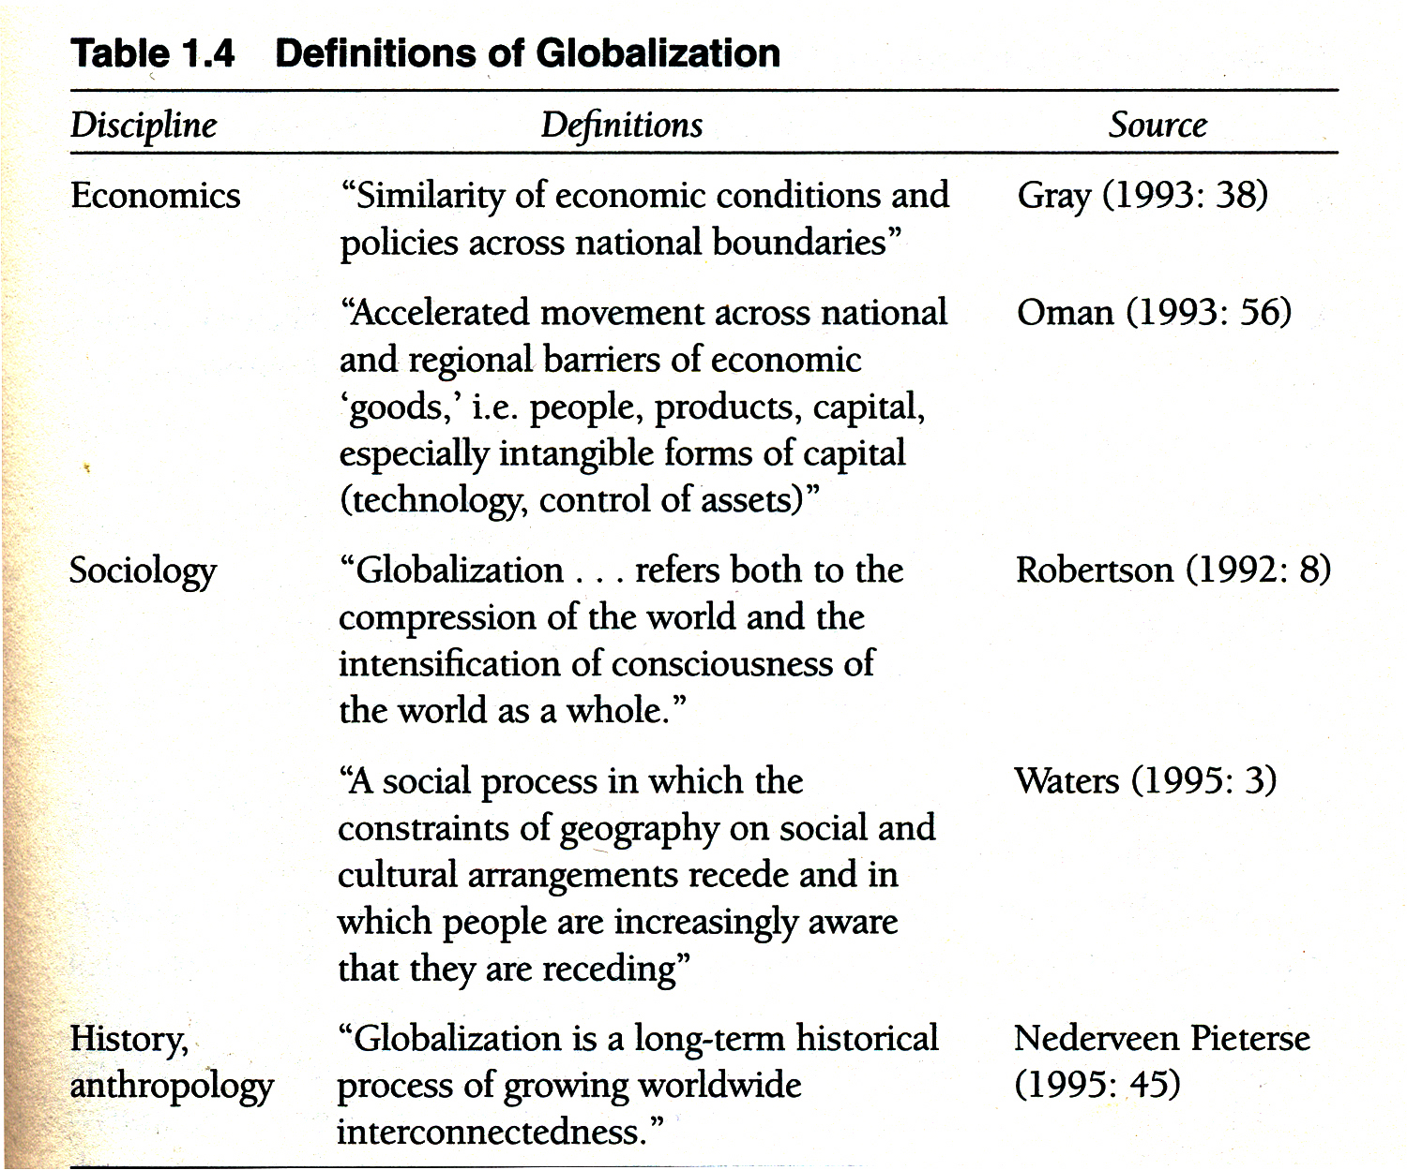

Slide 6
Issues foregrounded by globalisation
The flow of culture
The role of capitalism and the flow of money
The flow of people
The flow of information
The flow of ideas

Slide 7
Perspectives on globalisation
Kwame Anthony Appiah (1992 ) ‘In my father’s house : Africa in the philosophy of culture’
Globalisation as a spatial phenomenon - deepening/stretching,
Time space compression, (David Harvey), time space distantiation (Giddens)
Marshall McLuhan’s ‘Global Village’

Slide 8
Globalisation, democracy and the nation state
Centres of power
Transnational corporations
National cultures
Loss of autonomy
The end of the Westphalian state :
‘the organisation of the world by and around a system of sovereign, territorial nation states is gradually submerging beneath new kinds of (non territorial) linkages. The intensification of these linkages is in turn producing a new spatial and institutional configuration of social power – a “postinternational” system – whose shape corresponds less and less to the interstate model provided by orthodox International relations’ (Rosenberg, J : ‘The Follies of Globalisation theory)

Slide 9
Culture and globalisation
Four worlds
World systems theory - core/periphery, challenging the modernist paradigm
Dependency theory
Cultural flow :
‘World cultural flow, it appears, has a much more intricate organisation of diversity than is allowed in a picture of a centre-periphery structure with just a handful of all purpose centres. A further issue, obviously, if one tries to arrive at a present day global cultural flow chart, is to what extent indeed the peripheries talk back; which would in large part be a question of the cultural influence of theThird World on the Occident’ (Hannerz, 1997 : 13)
Post colonial as opposed to third world (Ankie Hoogvelt)

Slide 10
‘it groups together all formerly colonial societies despite differences in their relation to the global capitalist system, whilst at the same time offering a point of entry for the study of those differences. This point of entry is the aftermath of the colonial relation and the manner in which this becomes reconstituted and contested in the process of the present transformation of the global political economy’ (Hoogvelt,1997 : XV)

Slide 11
‘Structural adjustment has helped to tie the physical economic resources of the African region more tightly into servicing the global system, while at the same time oiling the financial machinery by which wealth can be transported out of Africa and into the global system’ (Hoogvelt, 1997 : 171)

Slide 12
‘theorisation and representation of culture has changed in the postwar period in response to a succession of geopolitical and geocultural shifts’ (Frederick Buell,1994 : 337).
‘nation-states as a grid that has been superimposed upon a deeper and ongoing stratum of human migrations and diasporas’ (Pieterse, 2004 : 34).
‘recognises and absorbs differences within the larger, overarching framework of what is essentially and American conception of the world’
(Stuart Hall)

Slide 13
Globalisation/localisation
‘it neglects the extent to which what is called local is in large degree
constructed on a trans or super local basis’ (1995: 26).
‘simultaneity and interpenetration of what are conventionally called the global and the local, or in a more abstract vein, the universal and the
particular’

Slide 14
Criticising globalisation
eurocentric and universalist
Globalisation as postmodern phenomenon

Slide 15
Alternative modernities

